Slide 1

Exercise Work Presentation
Hung Phan

Slide 2
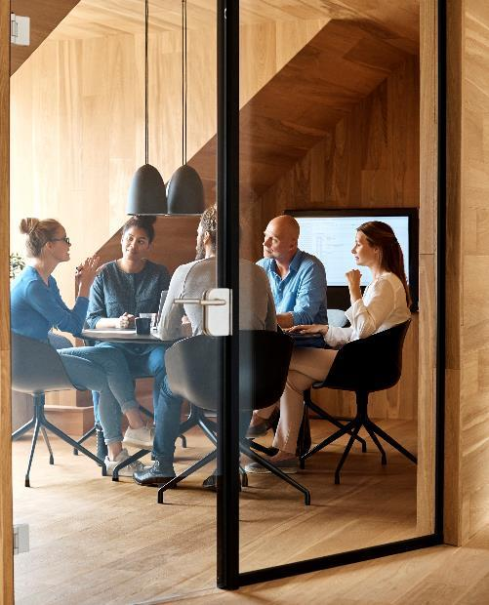



Introduction
ImageShop is built for creating a playground for artists, photographers, or designers, who want to share their ideas and passions.
Users can register an account and log in with which to upload the images into database.

Slide 3

ImageShop usage
Demo: HMTerest (amplifyapp.com)

Slide 4




Stacks used
ReactJS
JavaScript
Tailwind CSS
Firebase

Slide 5

Application security

Slide 6
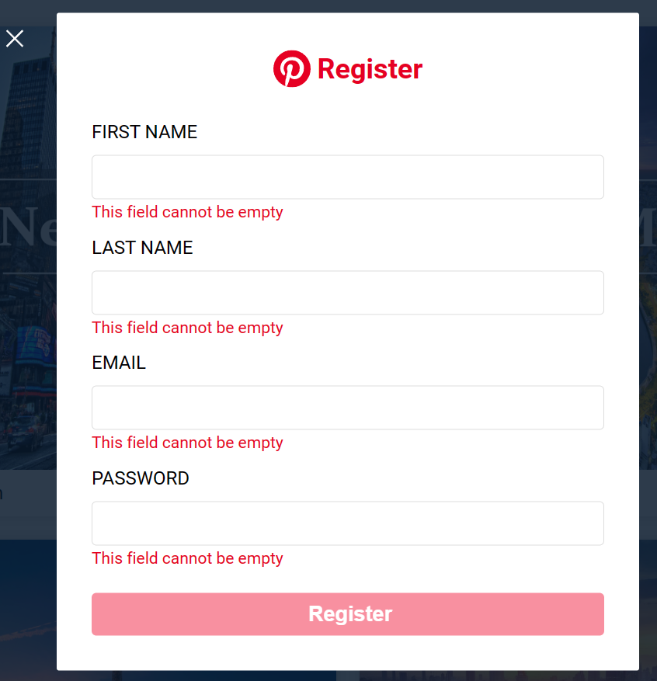
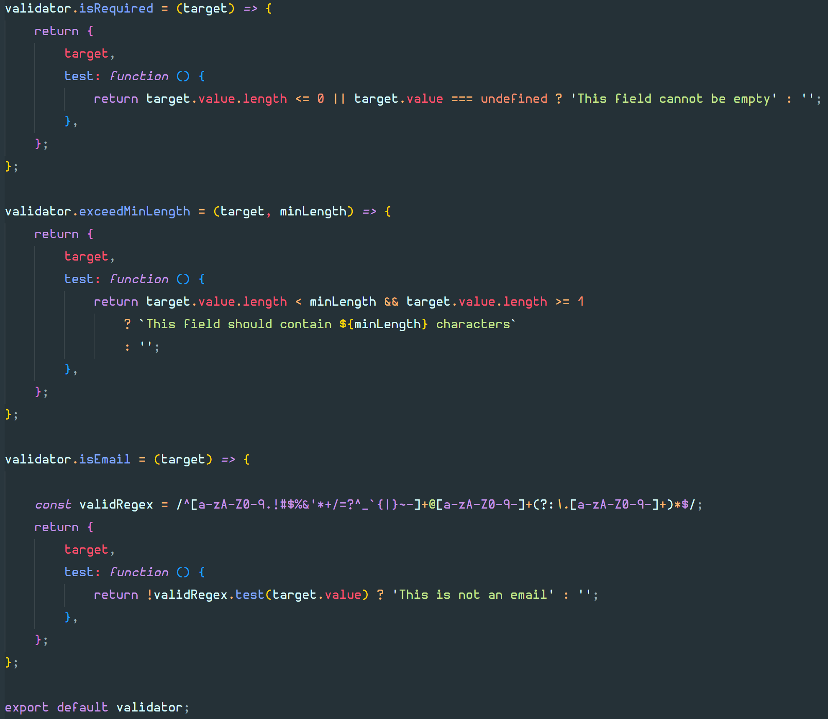
Input Validation

Slide 7
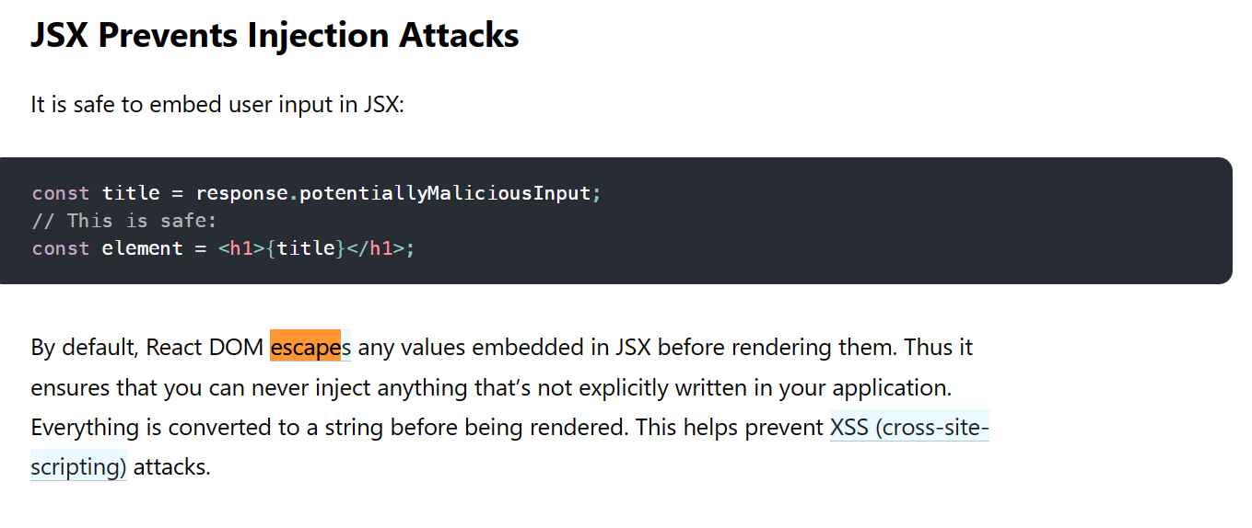
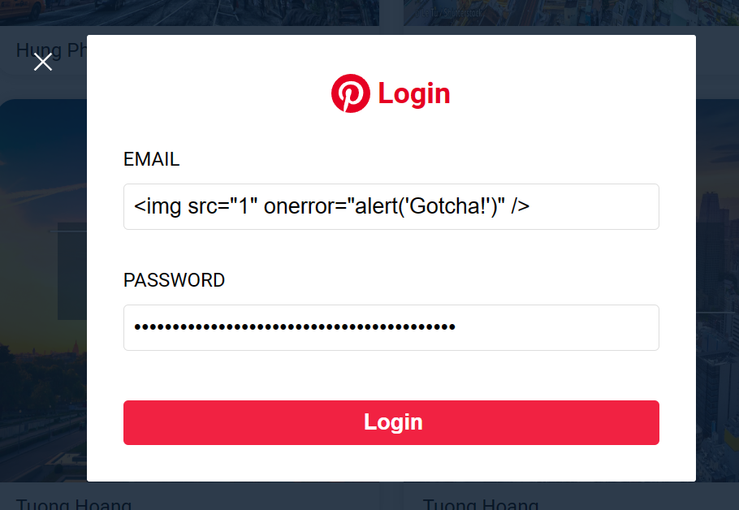
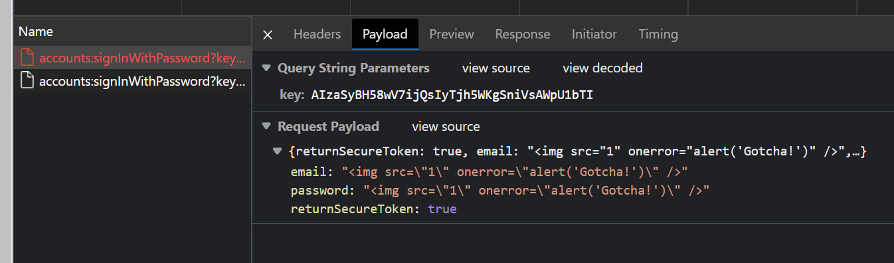
Input Sanitization

Slide 8
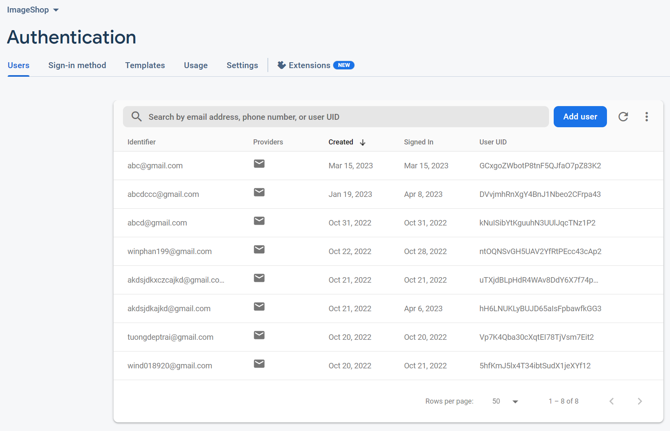
Authentication
Firebase Authentication is used for the ImageShop web application. Because this is a qualified third-party service provided by Google. Therefore, The information can be secured.
All the created users will be assigned a unique user id or UID which will be used to identify user credentials.

Slide 9
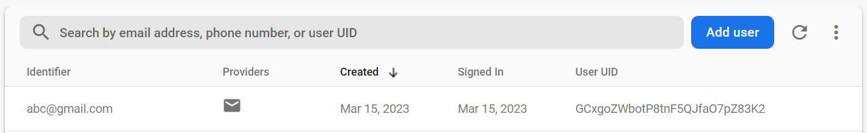
Authentication
Create the same user credential.
Login with the wrong password.

Slide 10
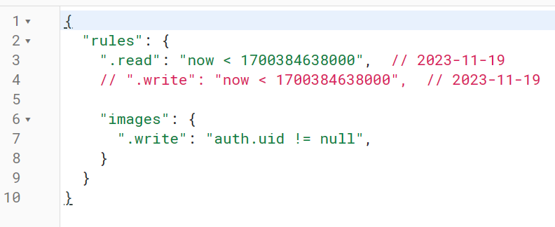
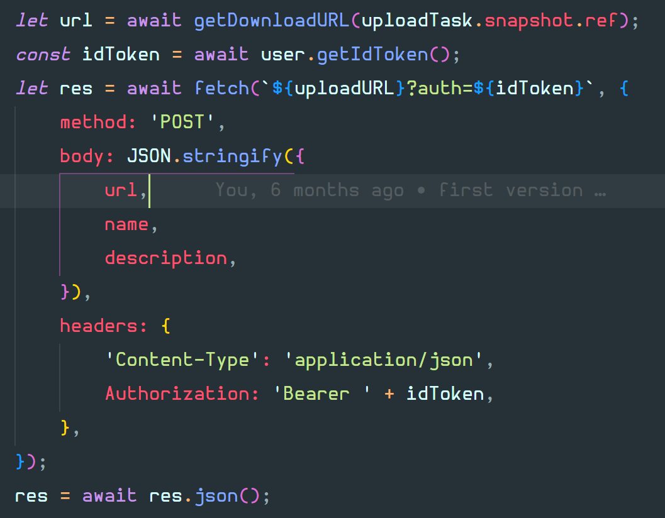
Request authorization
For the request posting images into database. I believe only the authorized one should be able to make the request to prevent CSRF attack.
Access token included

Slide 11
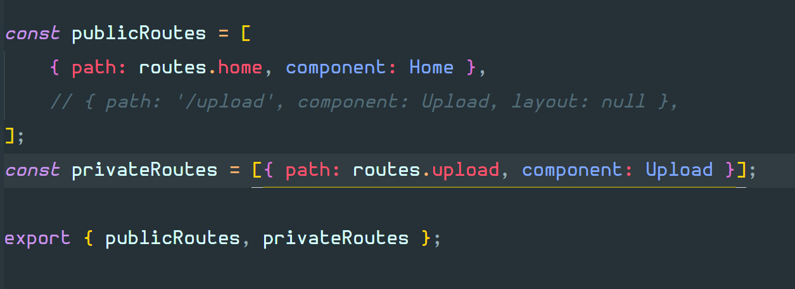
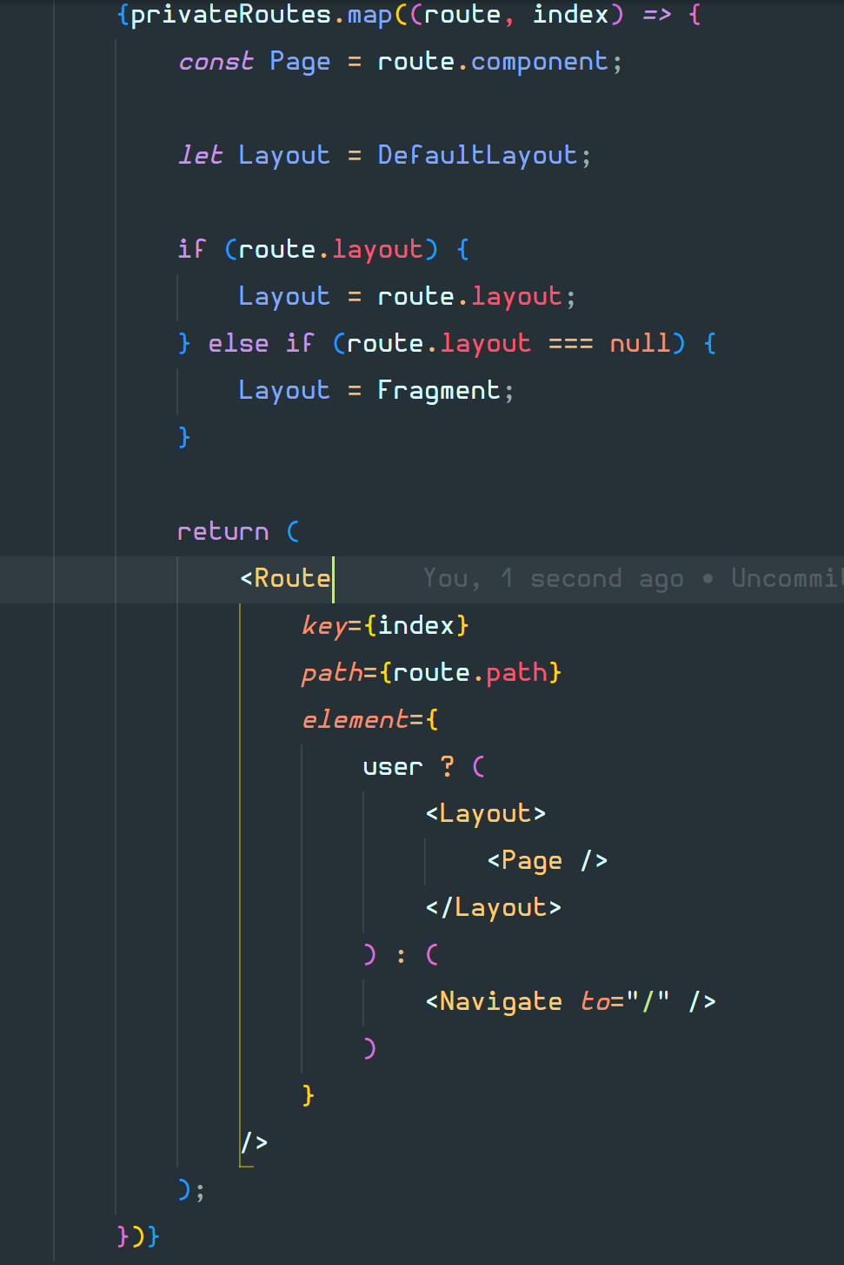
Route Protection
Check user is logged in
Routes division

Slide 12


Thank You
Hung Phan
Demo: HMTerest (amplifyapp.com)
GitHub: kisibongtoi1111/ImageShop (github.com)

